Slide 1
Ada Boost algorithm
Slides

Slide 2
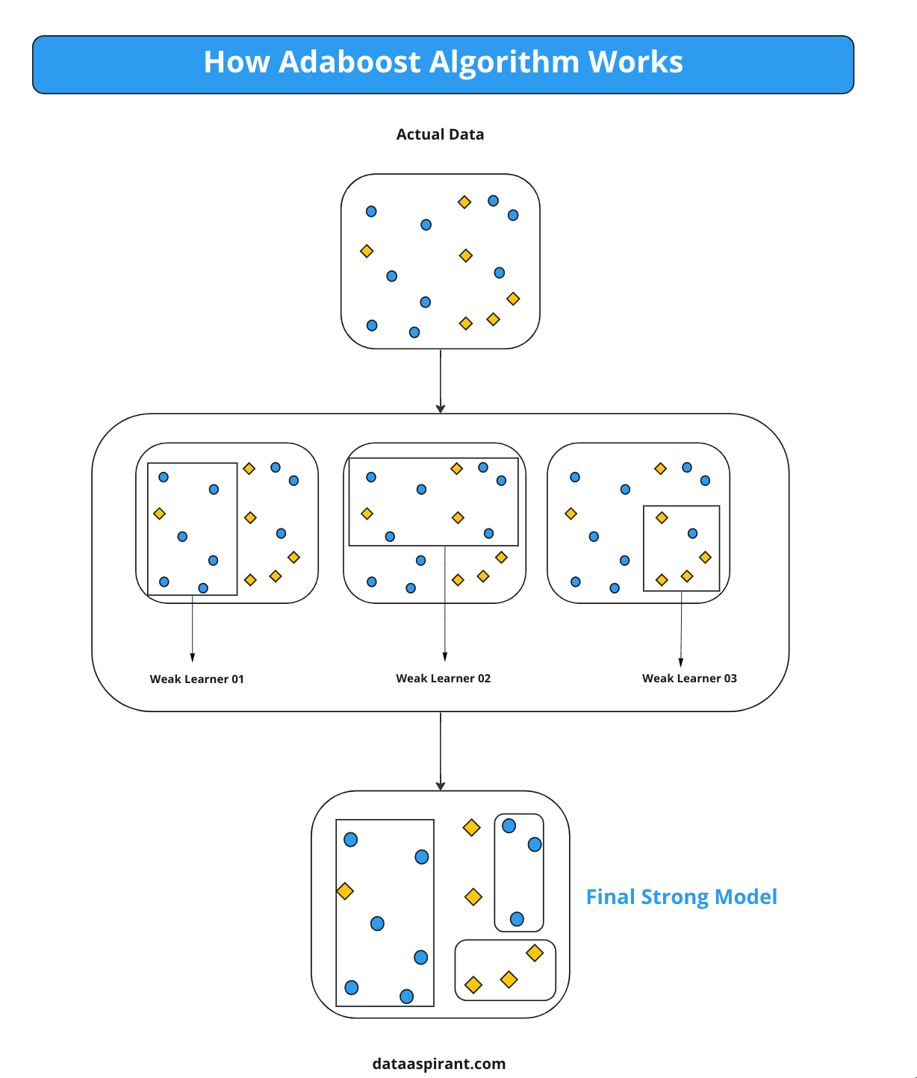
Ada Boost working Diagram

Slide 3
AdaBoost logic
Each model trained with different subset of data
All model average consider as prediction
It is sequential, increases bias reduction,
Base trees are usually very shallow (stumps with 1 split)

